Slide 1



Slide 2
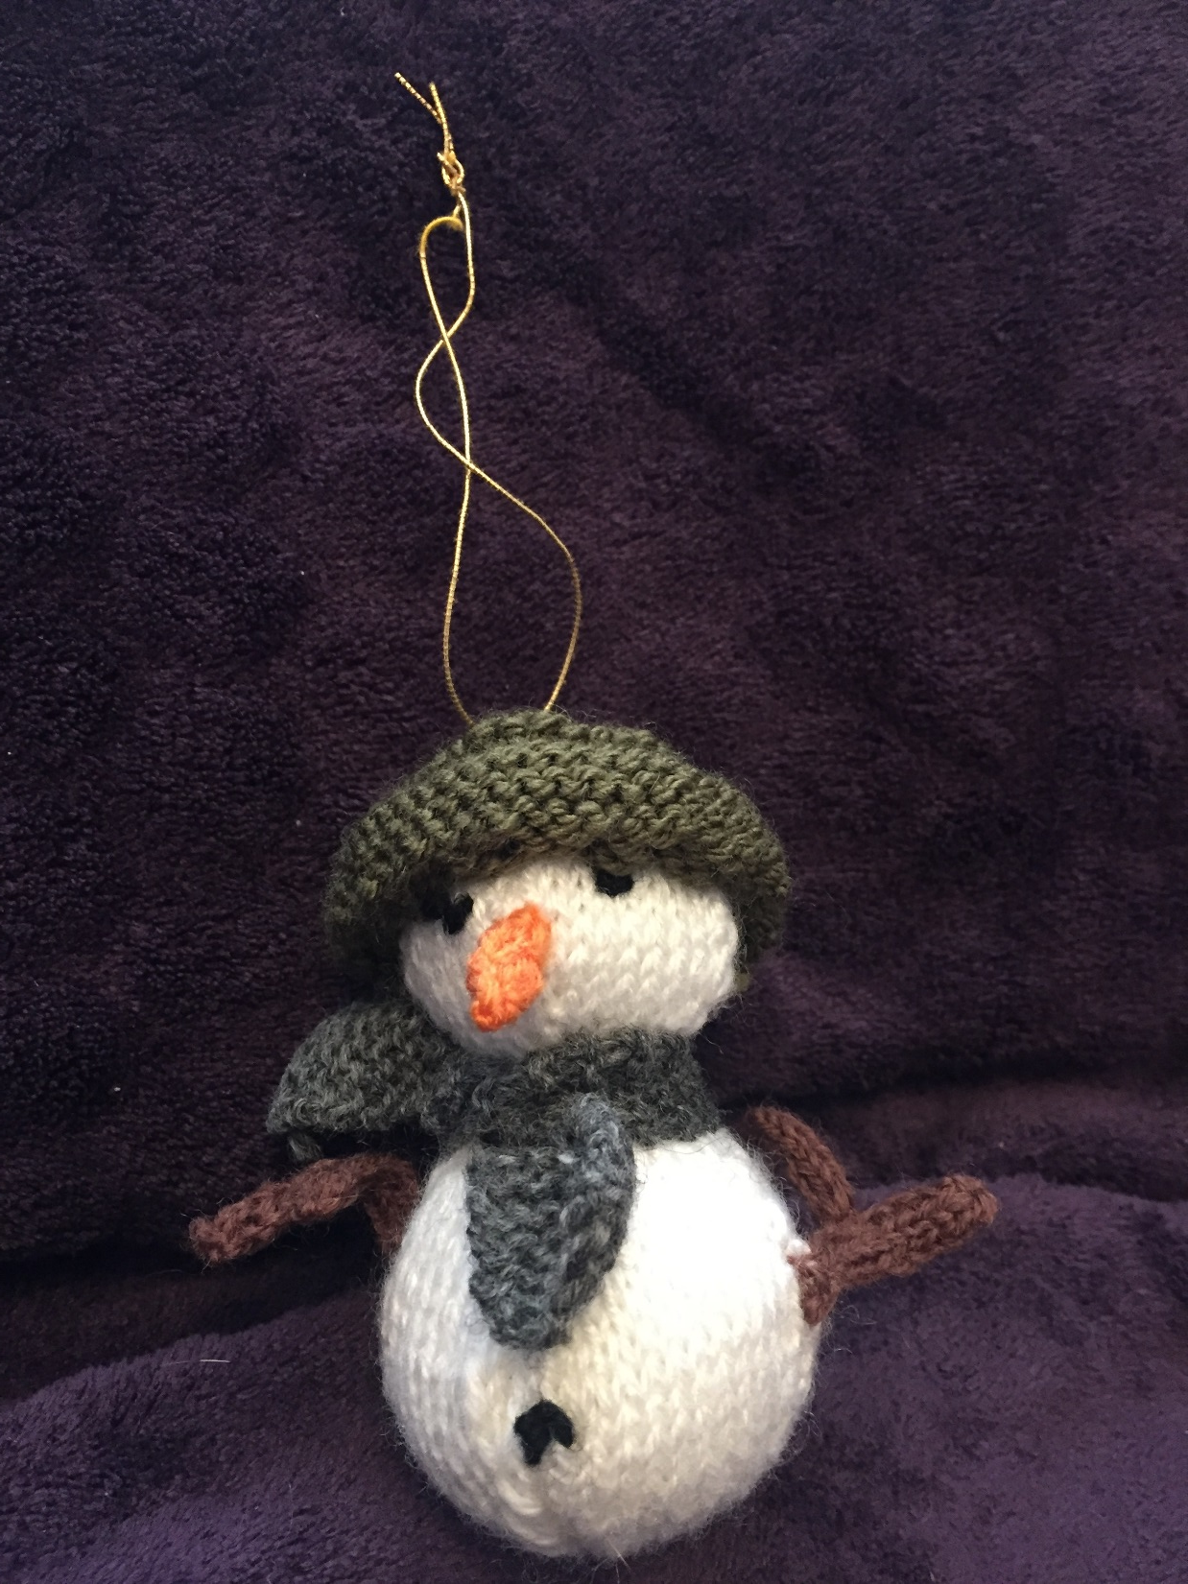
Snowman Tree Decoration £4

Slide 3
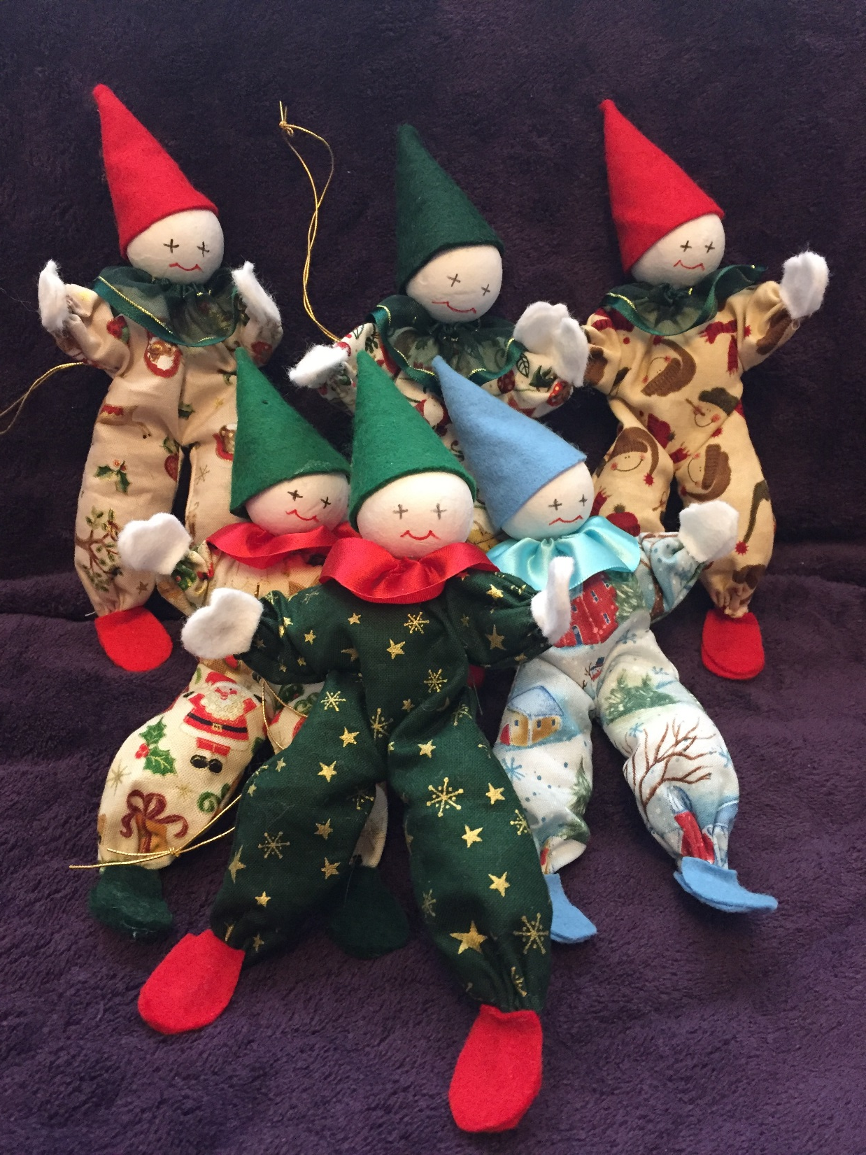
Set of Christmas Clowns £10

Slide 4
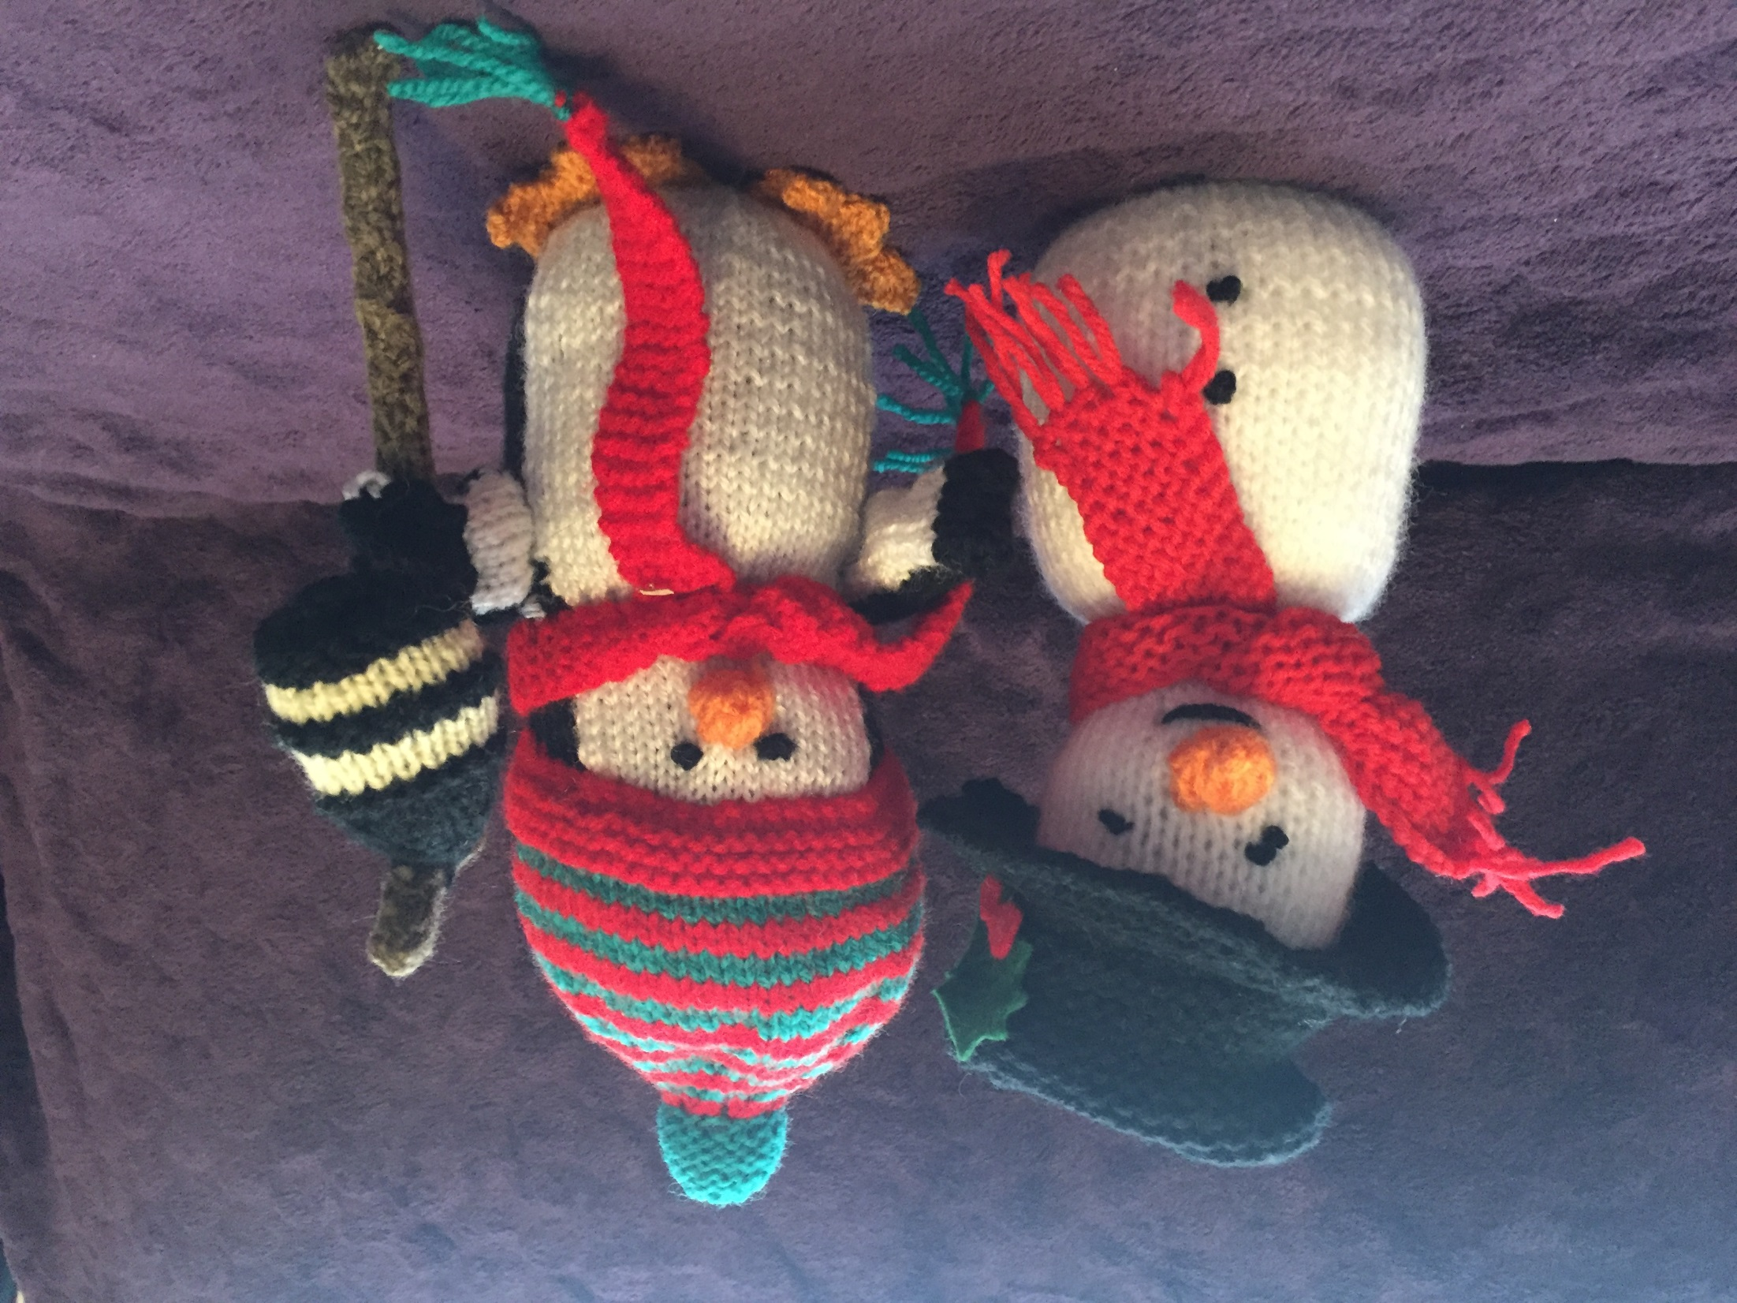
Christmas Penguins £6 each

Slide 5
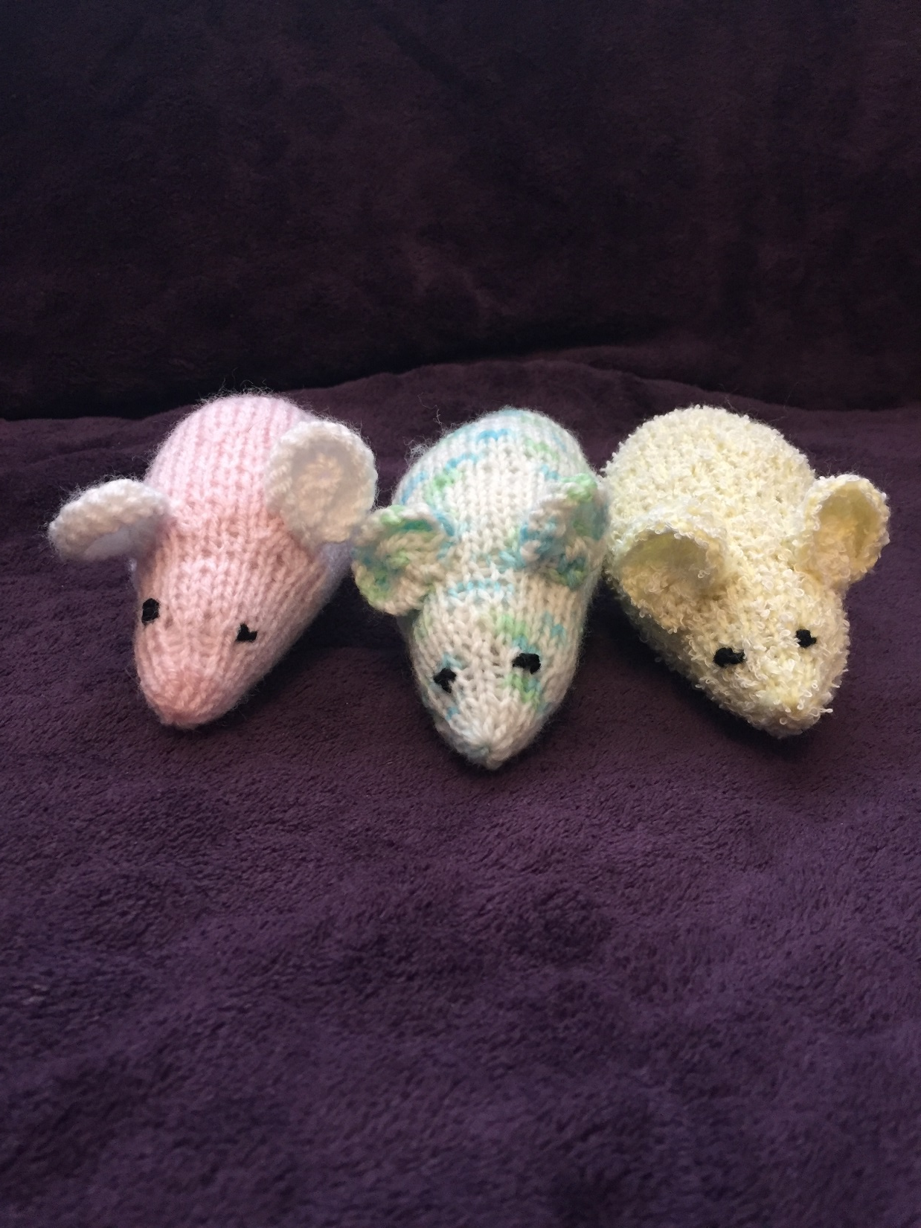
Sugar Mice £4 each

Slide 6
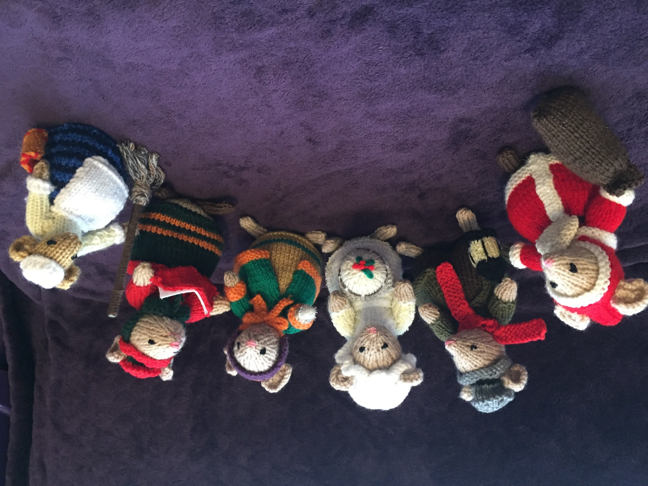
Christmas Mice £6 each

Slide 7
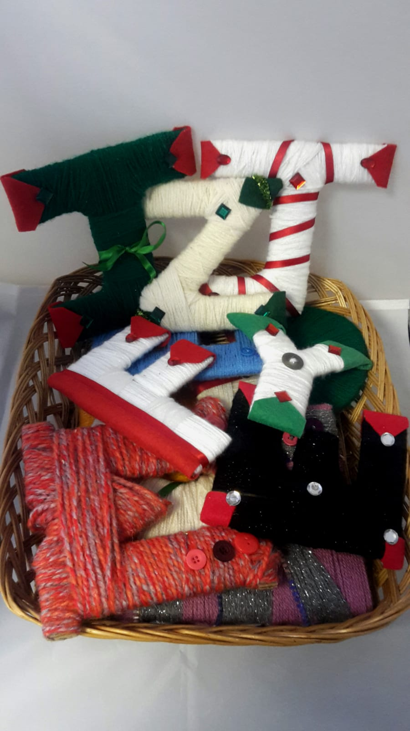
Letters £5 each

Slide 8
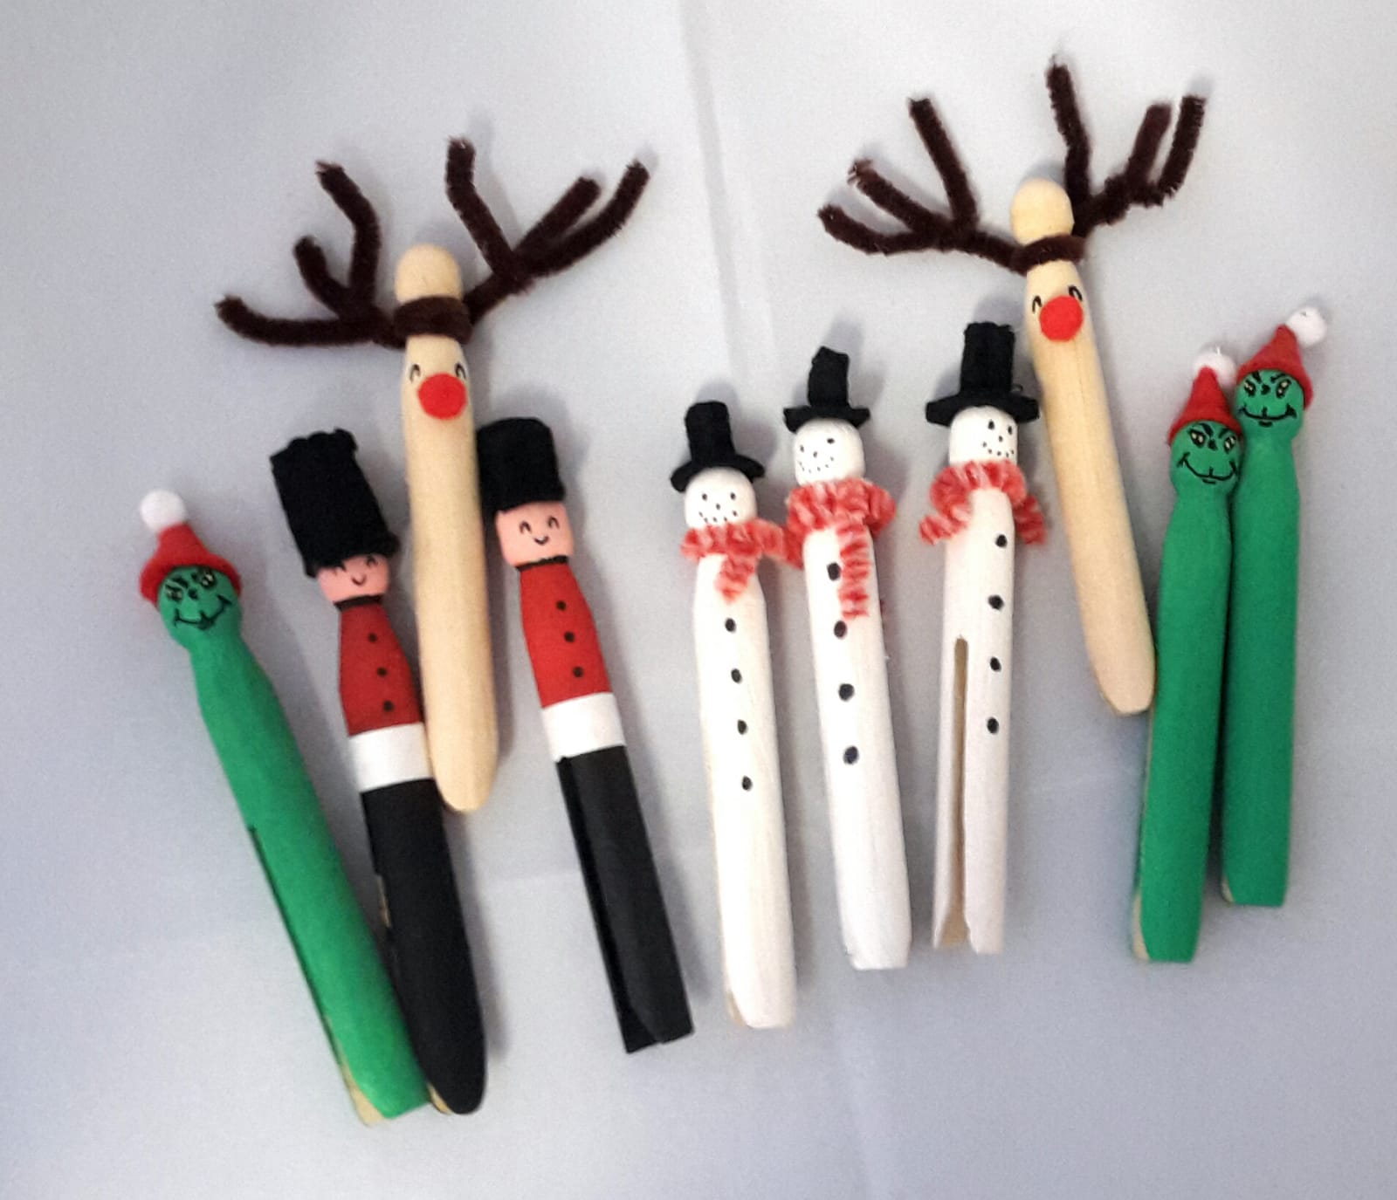
Christmas Pegs
Any 3 for £3

Slide 9
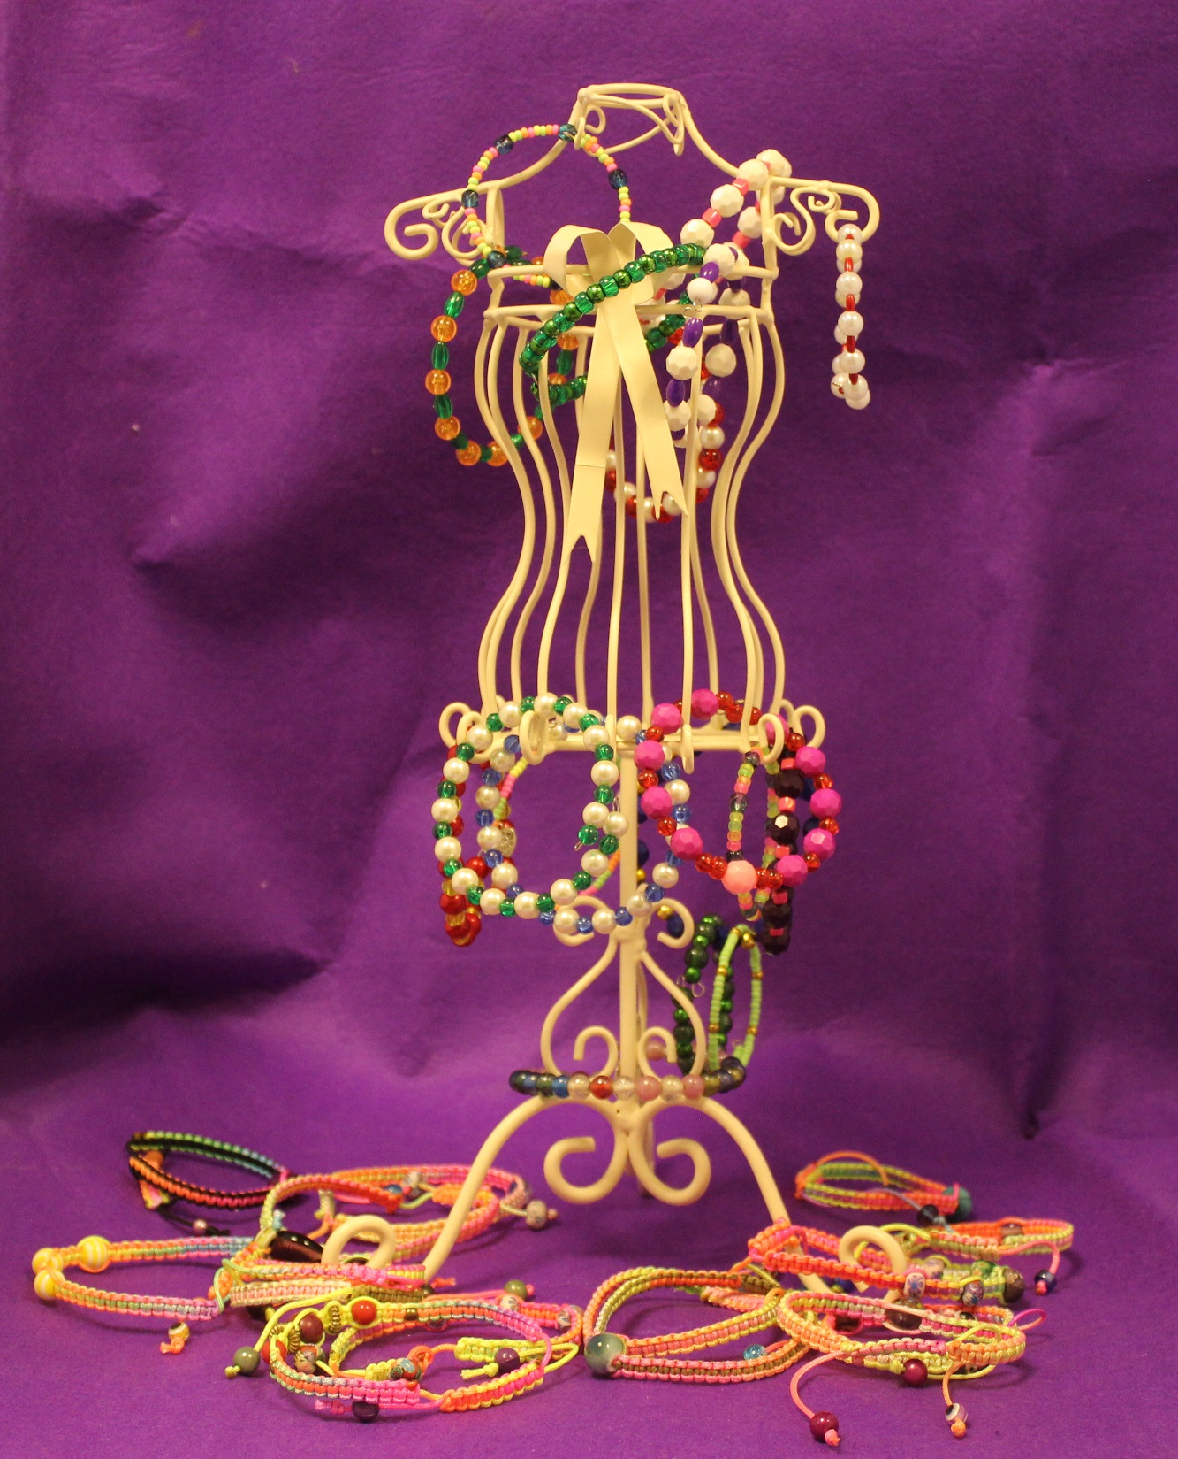
Bangles £4 each

Slide 10
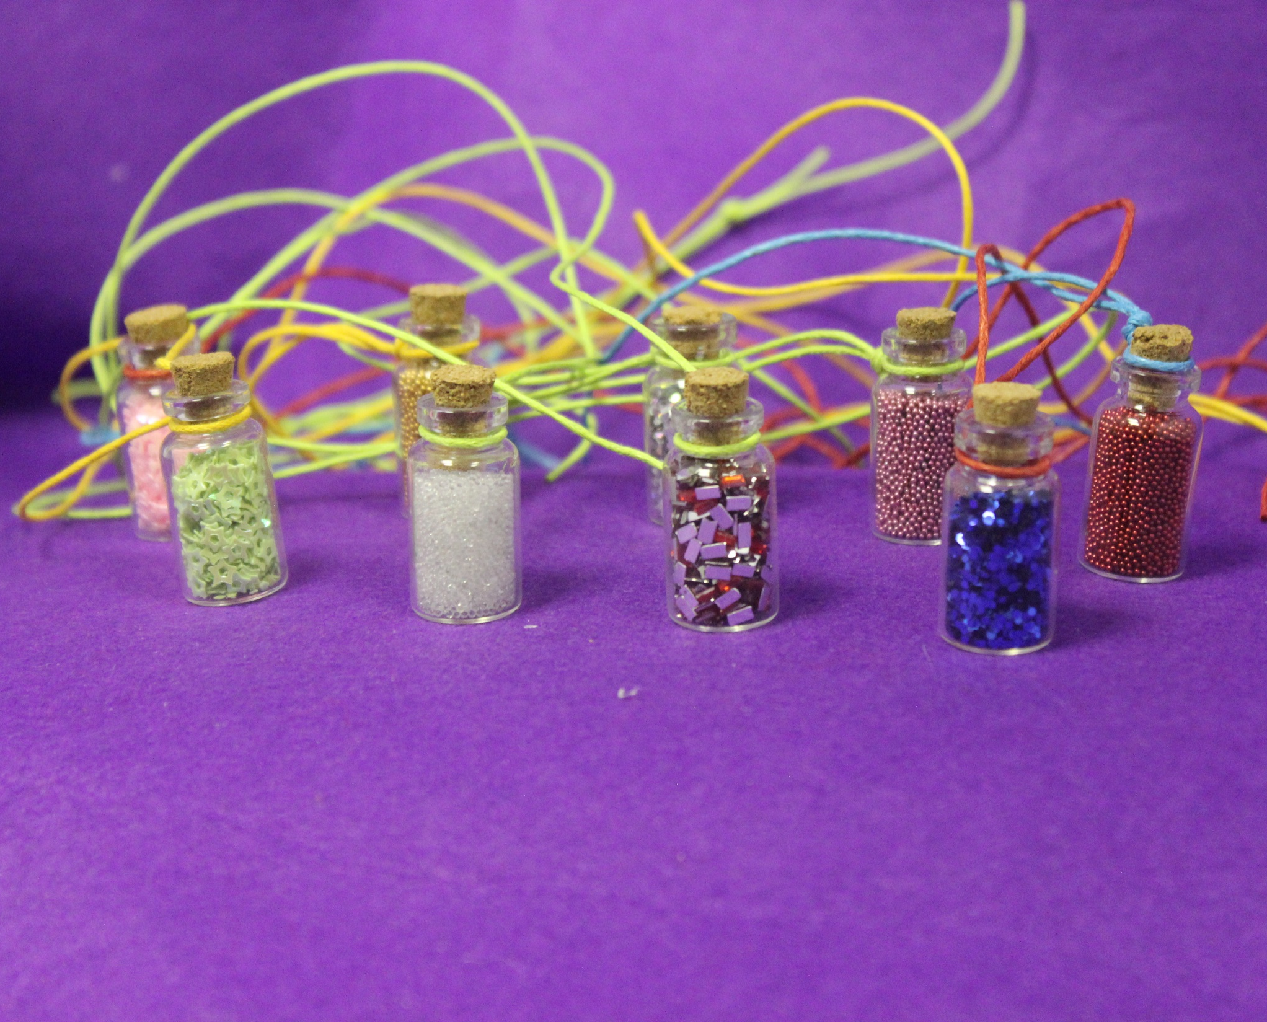
Charm Necklaces £2 each

Slide 11
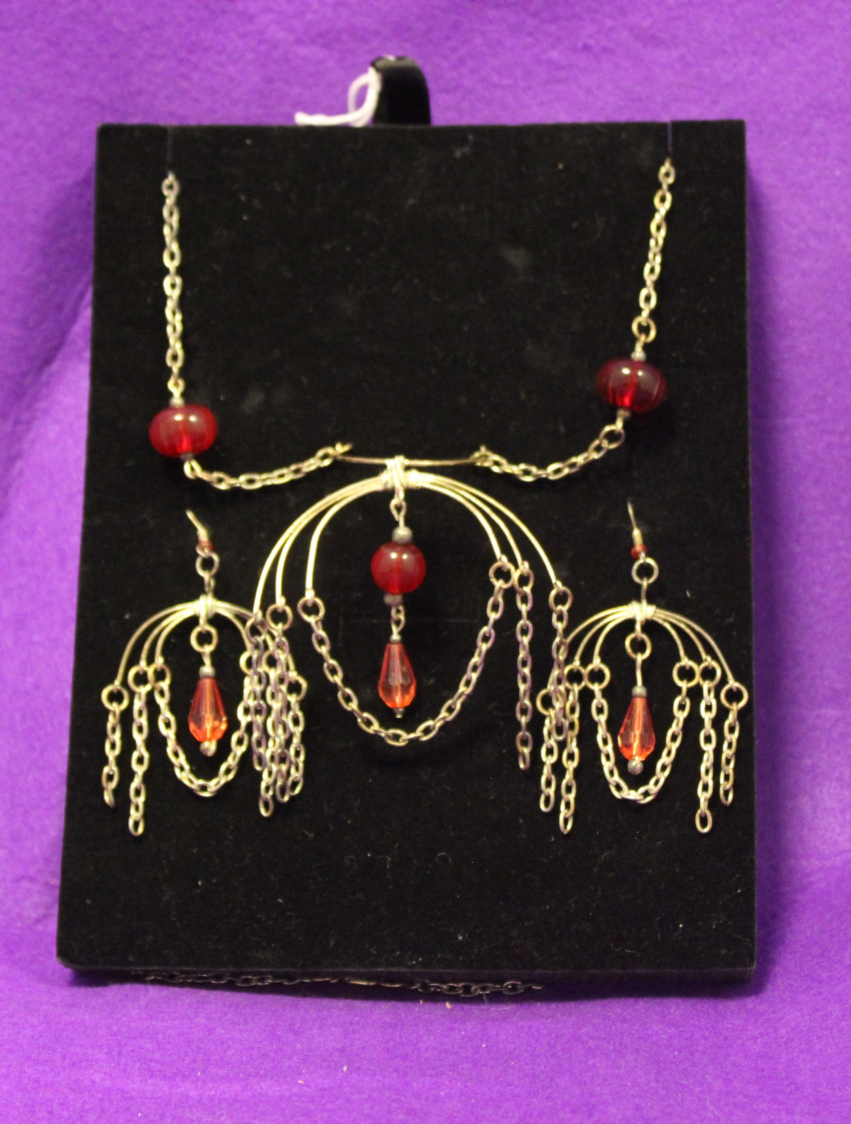
Necklaces £5 each

Slide 12
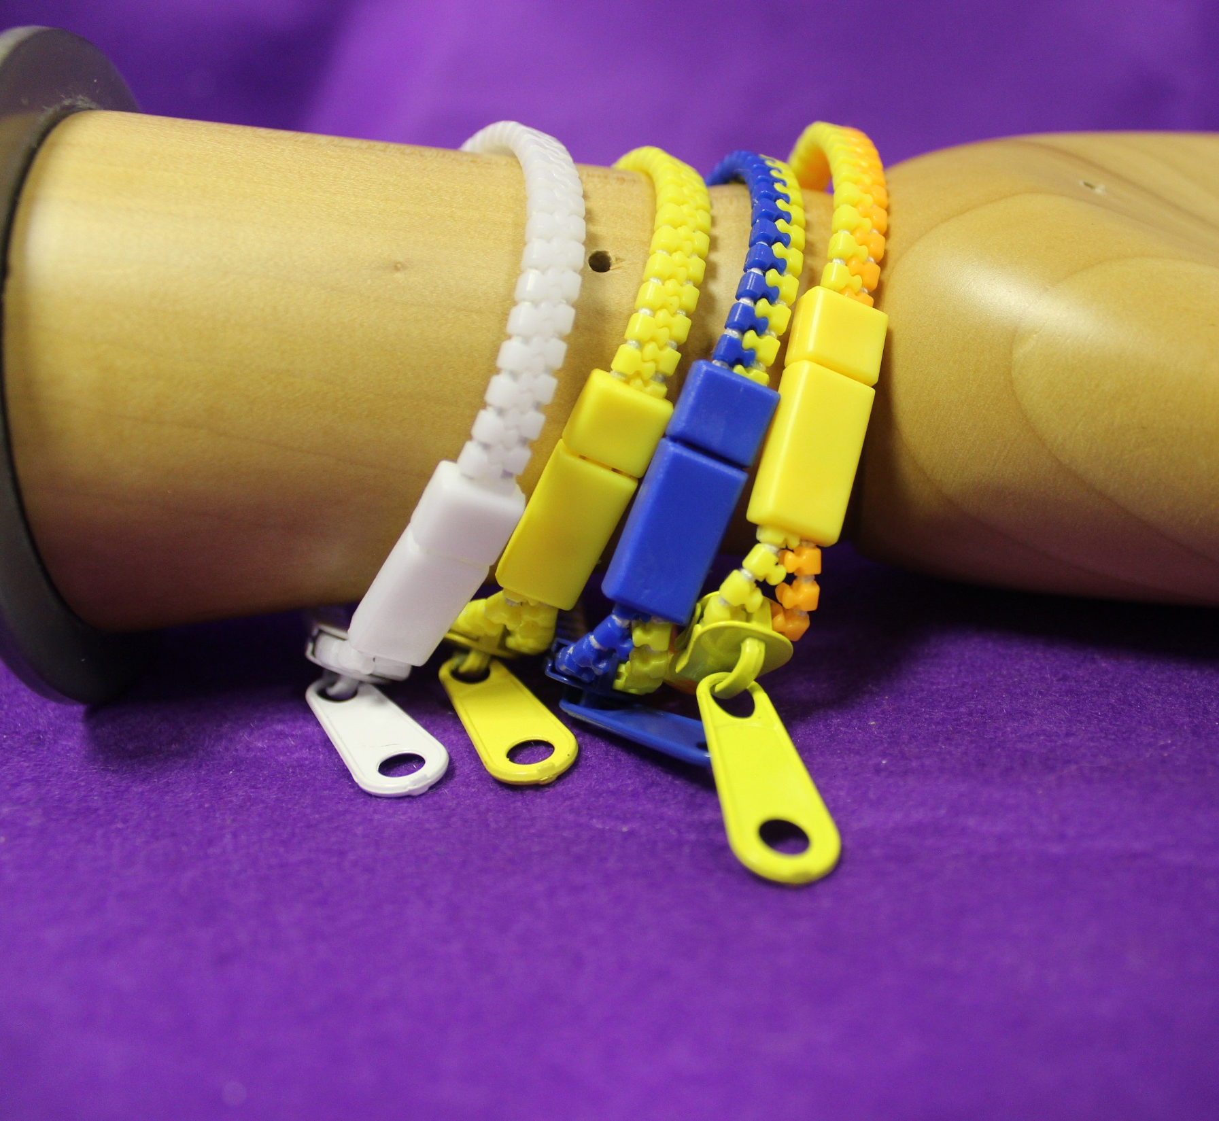
Broaches £2 each

Slide 13
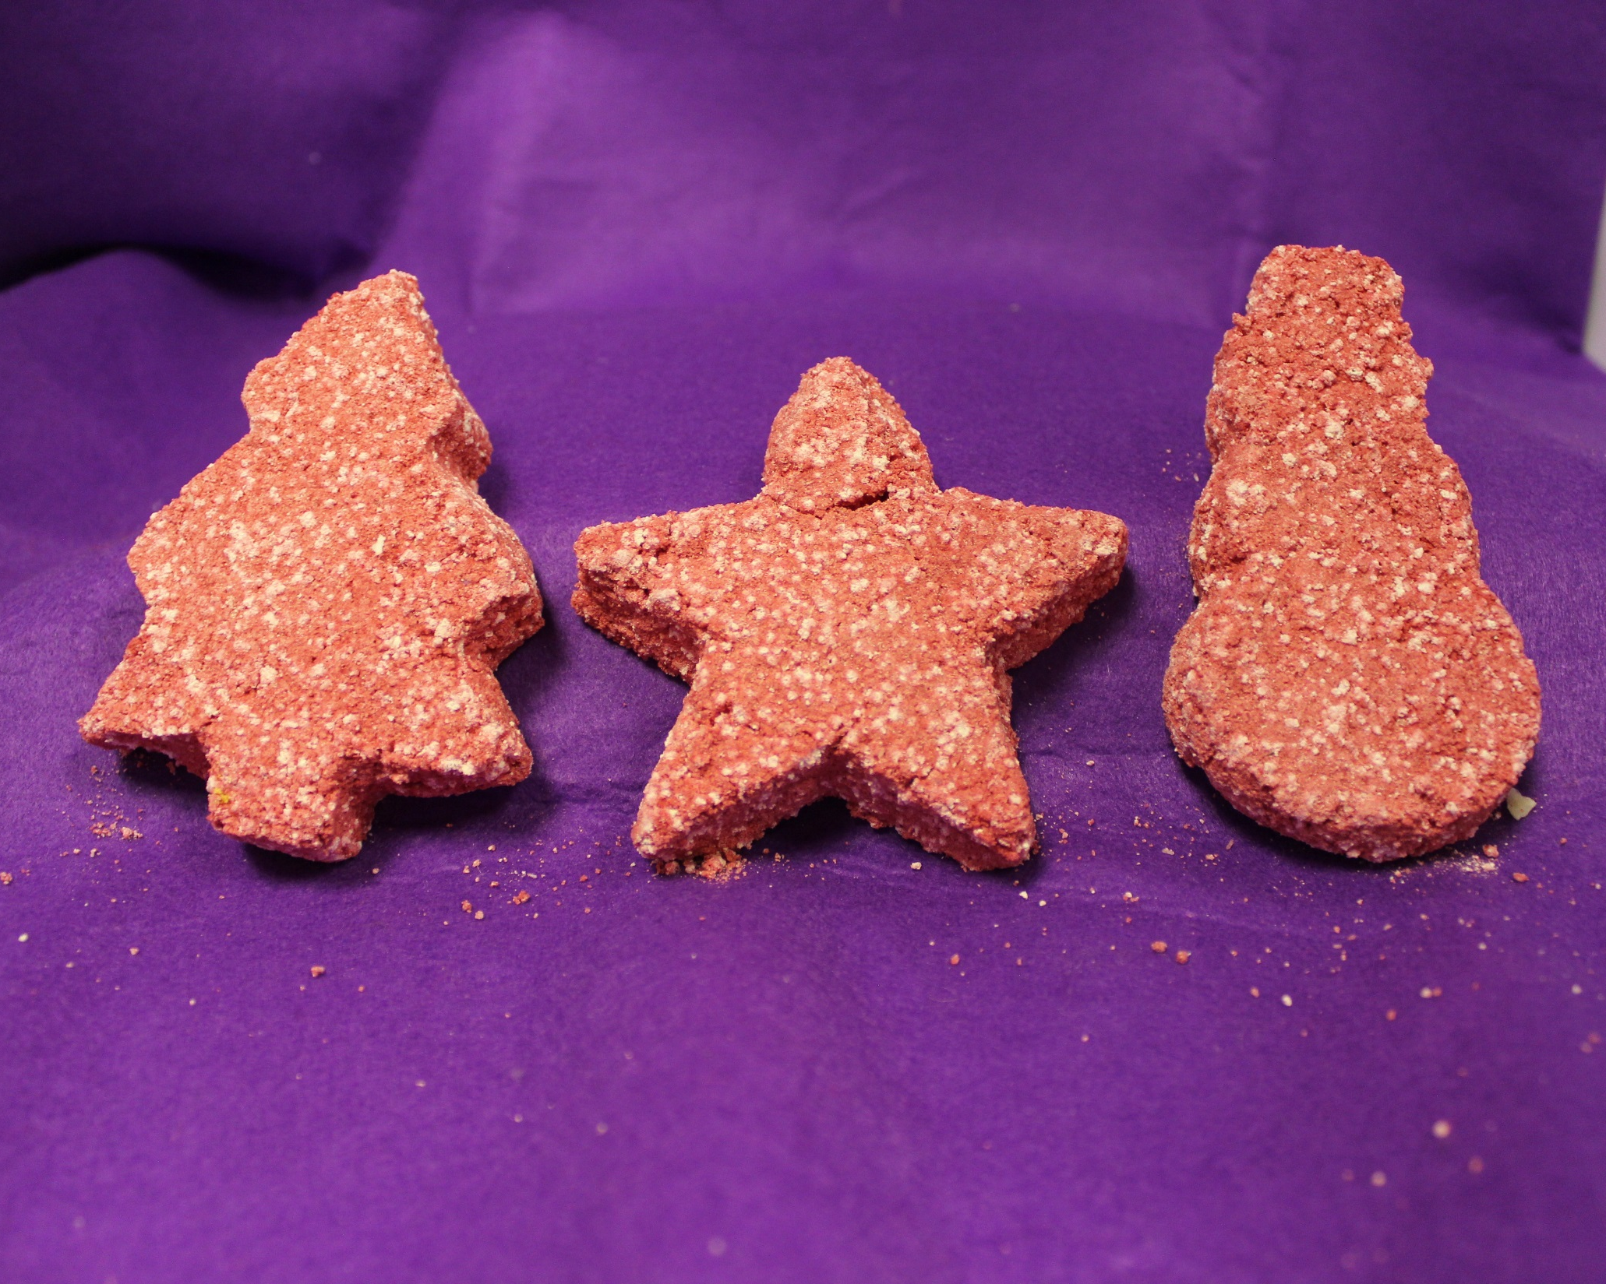
Christmas Bath Bombs £1.50 each

Slide 14
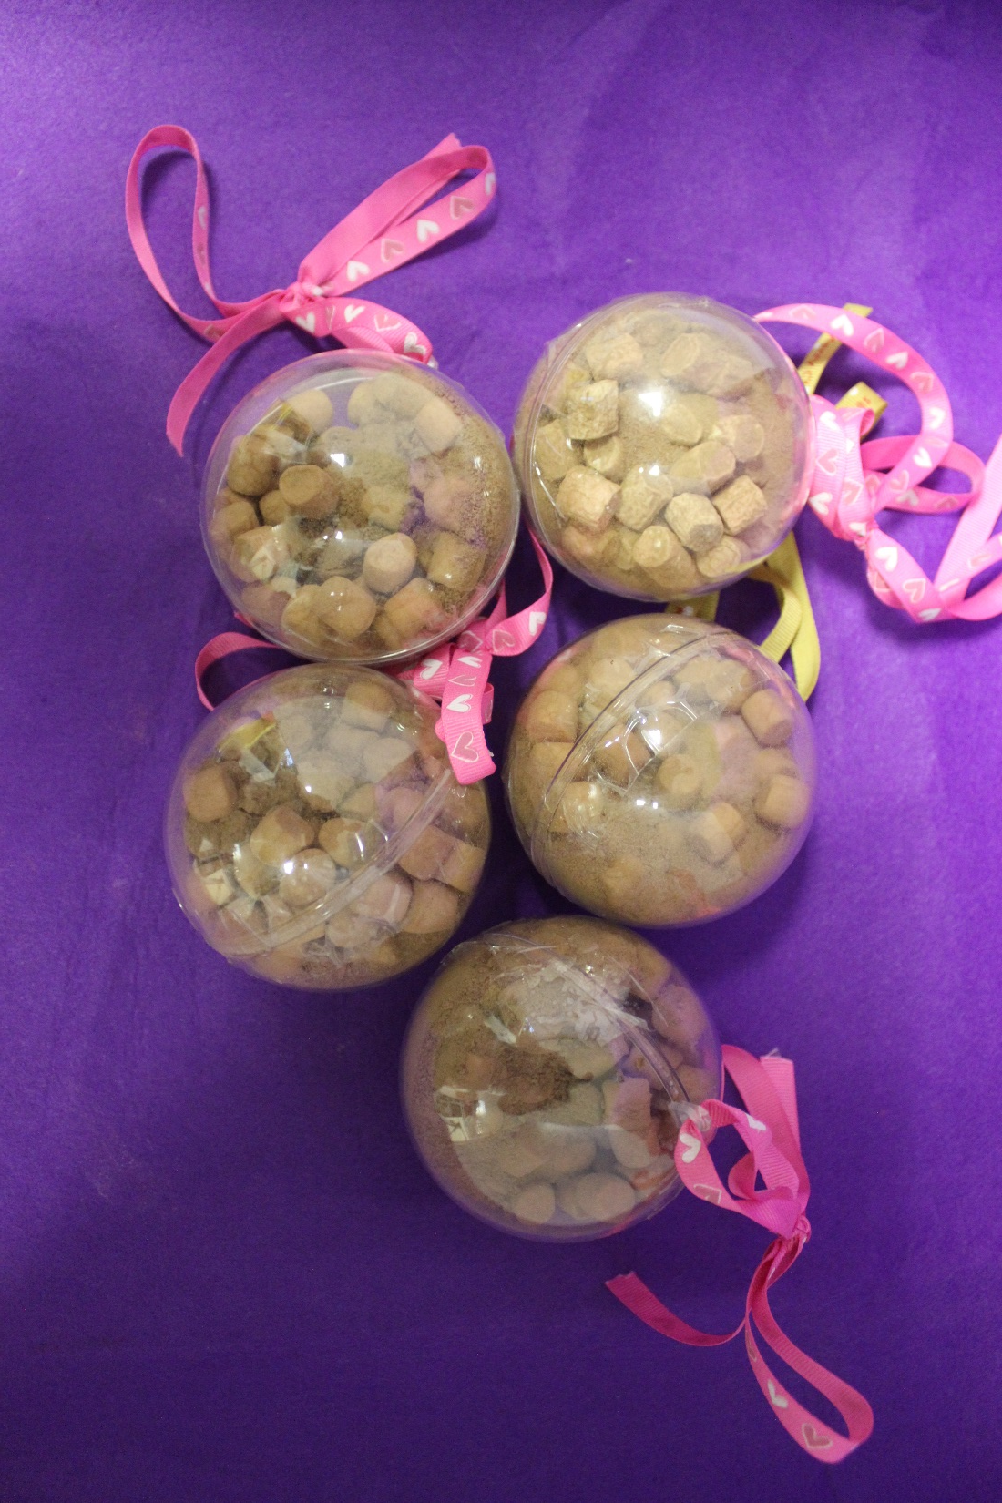
Hot Chocolate Christmas Baubles £3 each

Slide 15
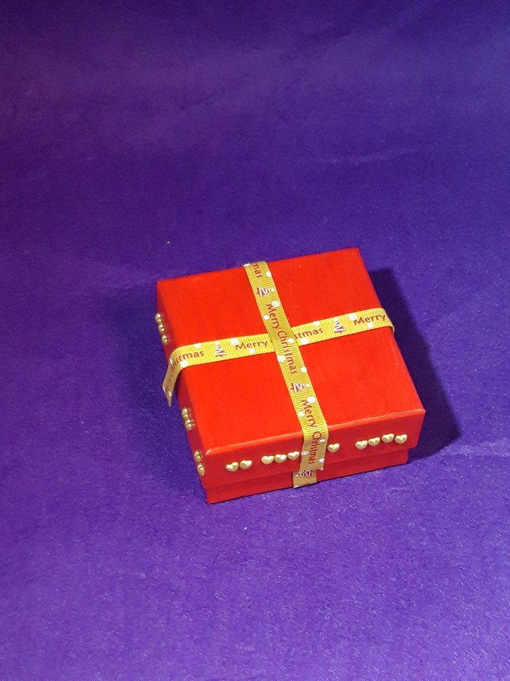
Christmas Themed Gift Boxes £2 each

Slide 16
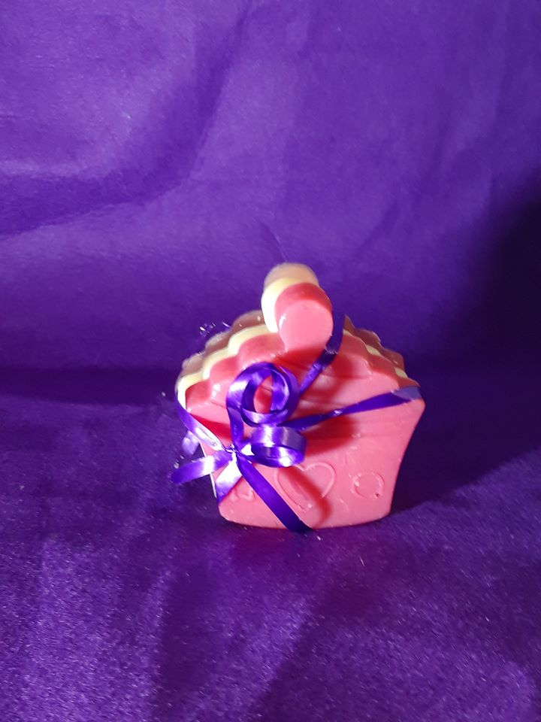
Gift Soap £2 each

Slide 17
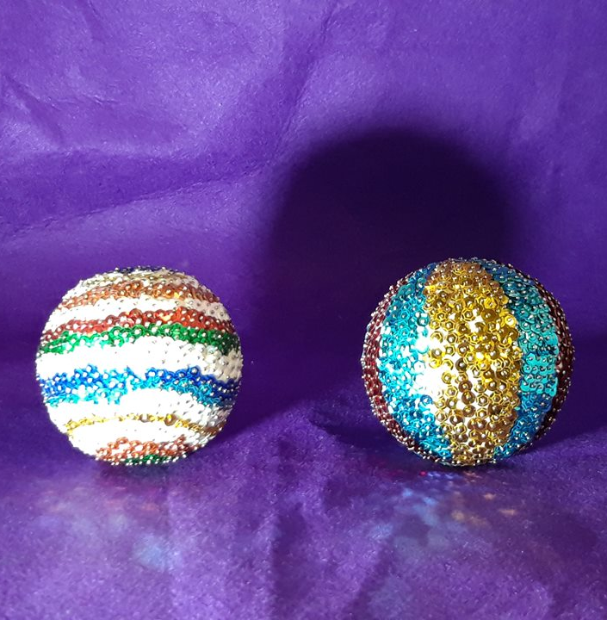
Shiny Baubles £6 each

Slide 18
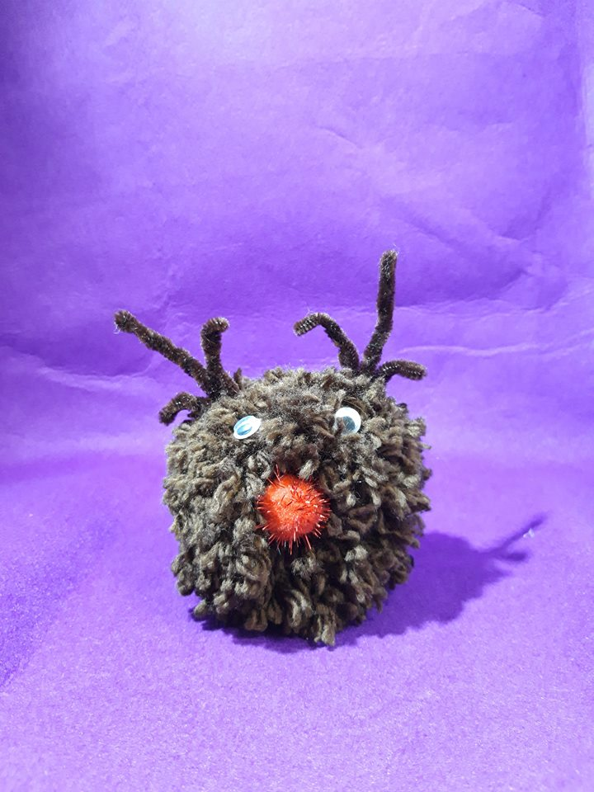
Reindeer Pompom £3 each

Slide 19
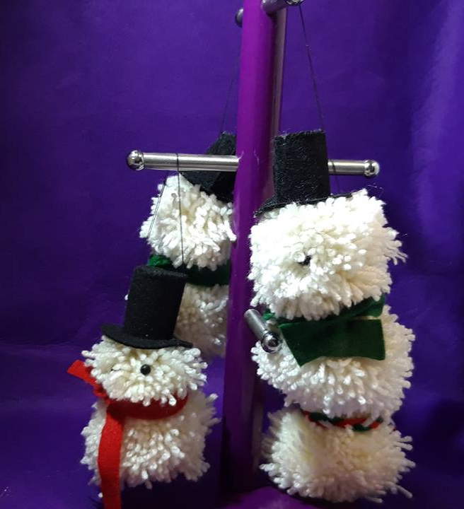
Snowmen Pompom Tree Decorations Any 3 for £3

Slide 20
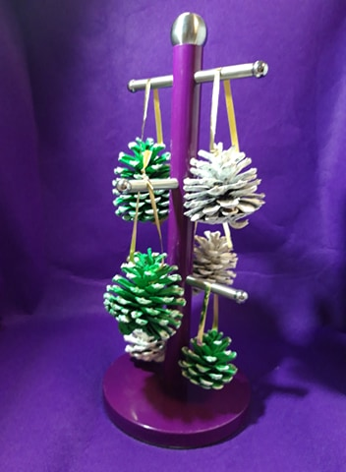
Pinecone Tree Decorations Any 2 for £2

Slide 21
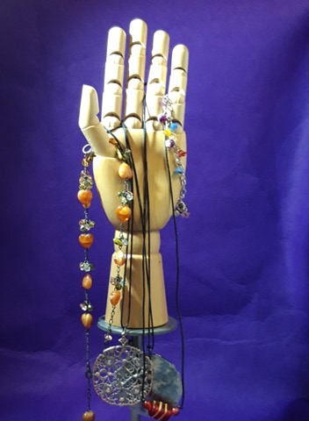
Braided Necklaces and Bangles £5 each

Slide 22
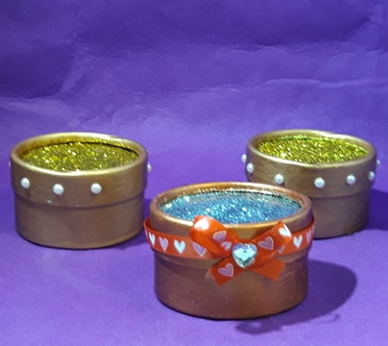
Copper Gift Boxes
£5 each

Slide 23
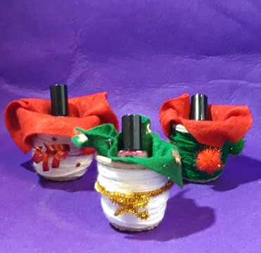
Christmas Nail Vanish Gifts
£2 each

Slide 24
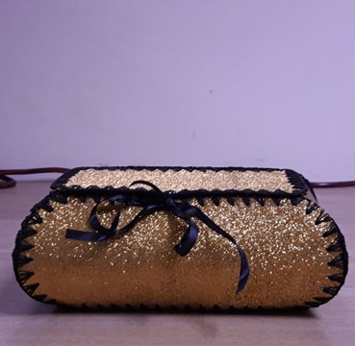
Golden Glitter Gift Box
£4.50

Slide 25
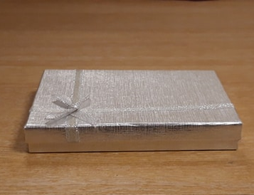
Silver Gift Box
£2.50

Slide 26
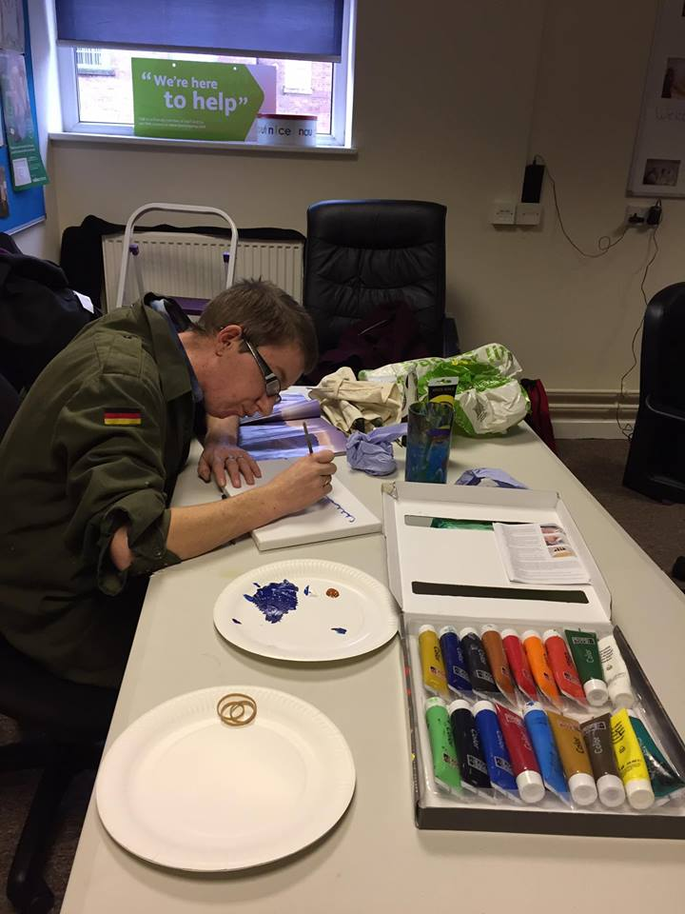
Art by Alex Lloyd

Slide 27
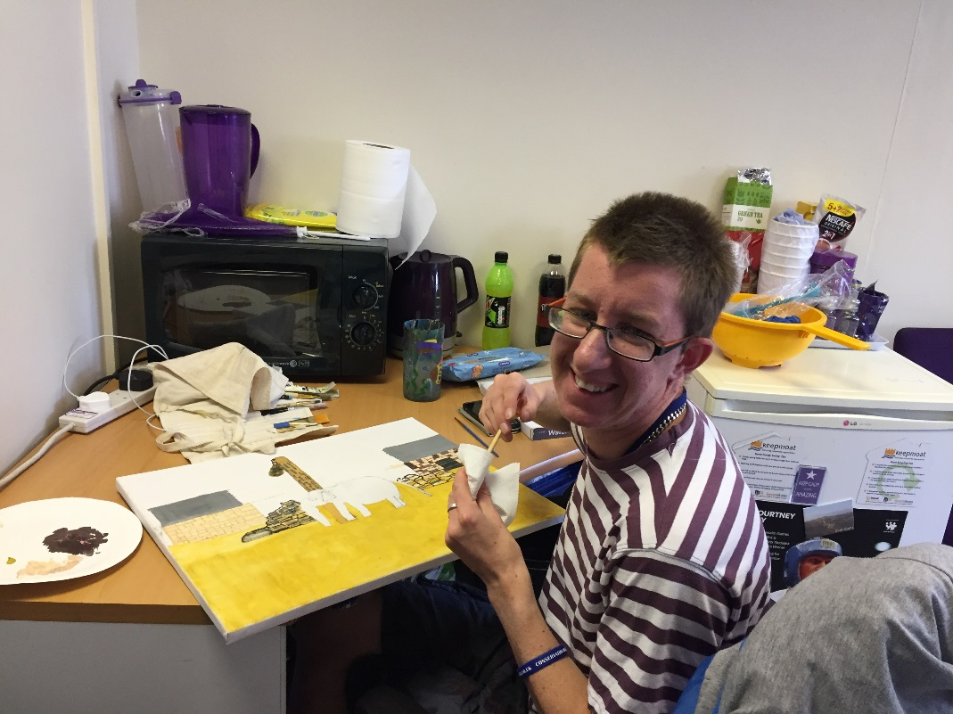
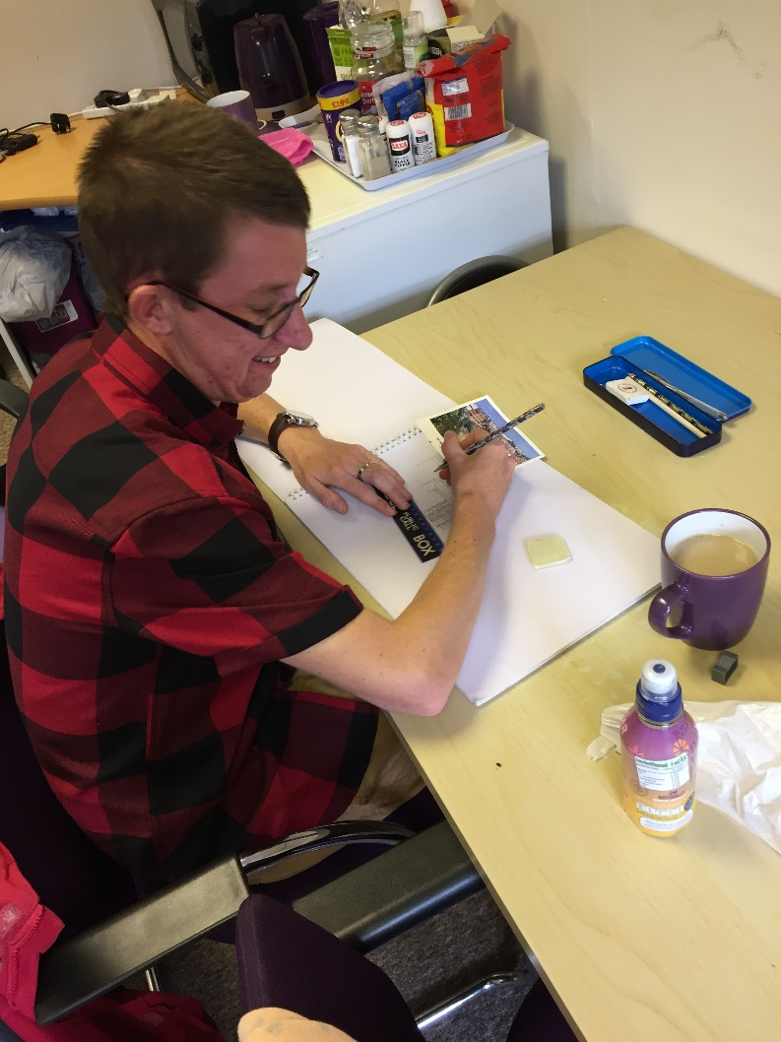
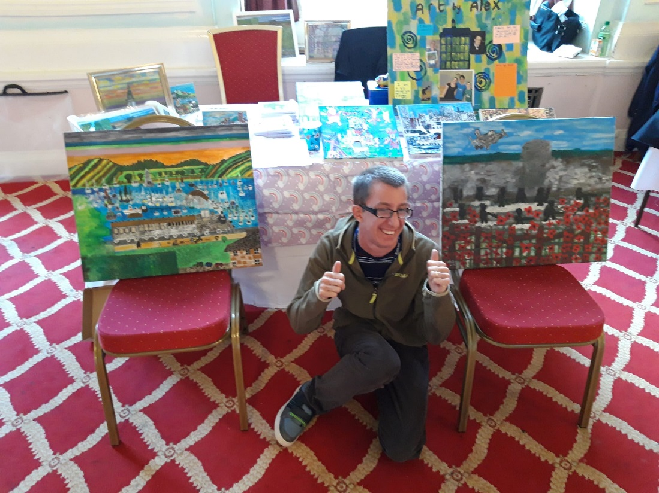
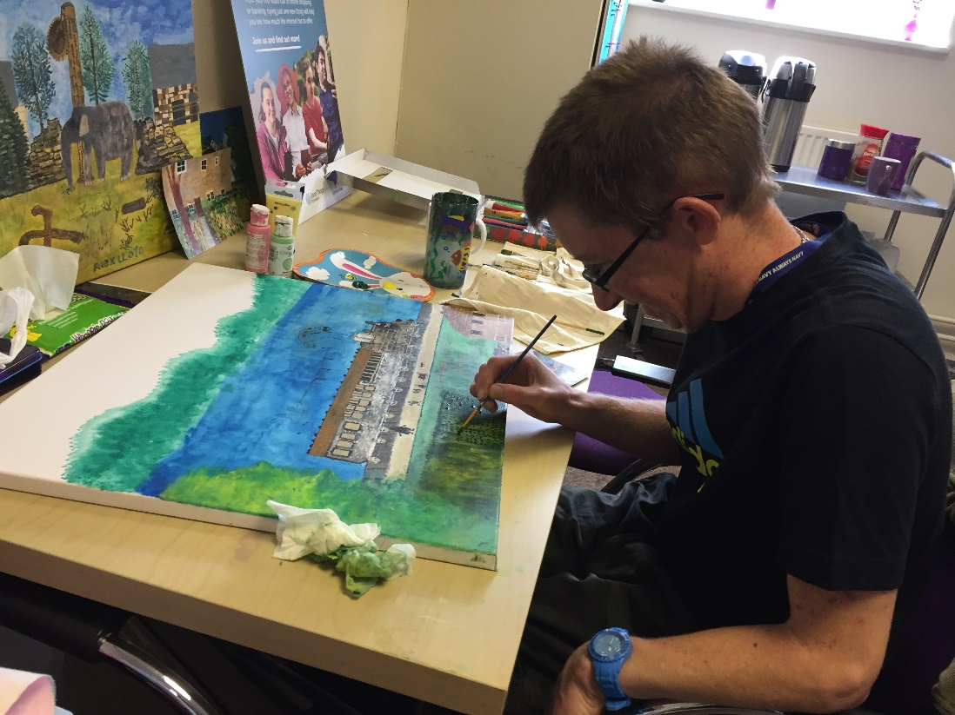
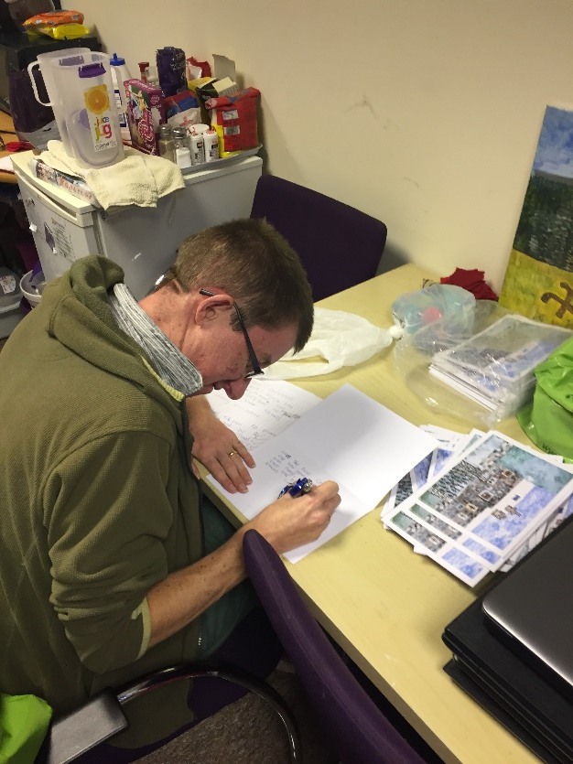
Here is a collage of Alex Lloyd creating many of his local art pieces that have been displayed in art exhibitions across the Merseyside region. I am inspired by places that I have been to as well as what I have a personal connection to.
To follow his art, click the link here https://www.facebook.com/ArtbyAlexLloyd/
For pricing of my art, please check my pricing list on the table in front

